Slide 1
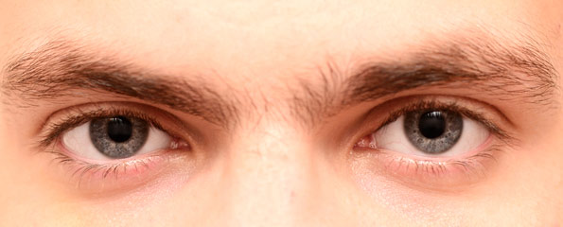


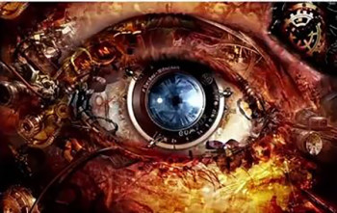
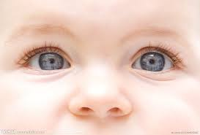

Computer Vision II: Recognition
Jingya Wang
Email: wangjingya@shanghaitech.edu.cn

Slide 2
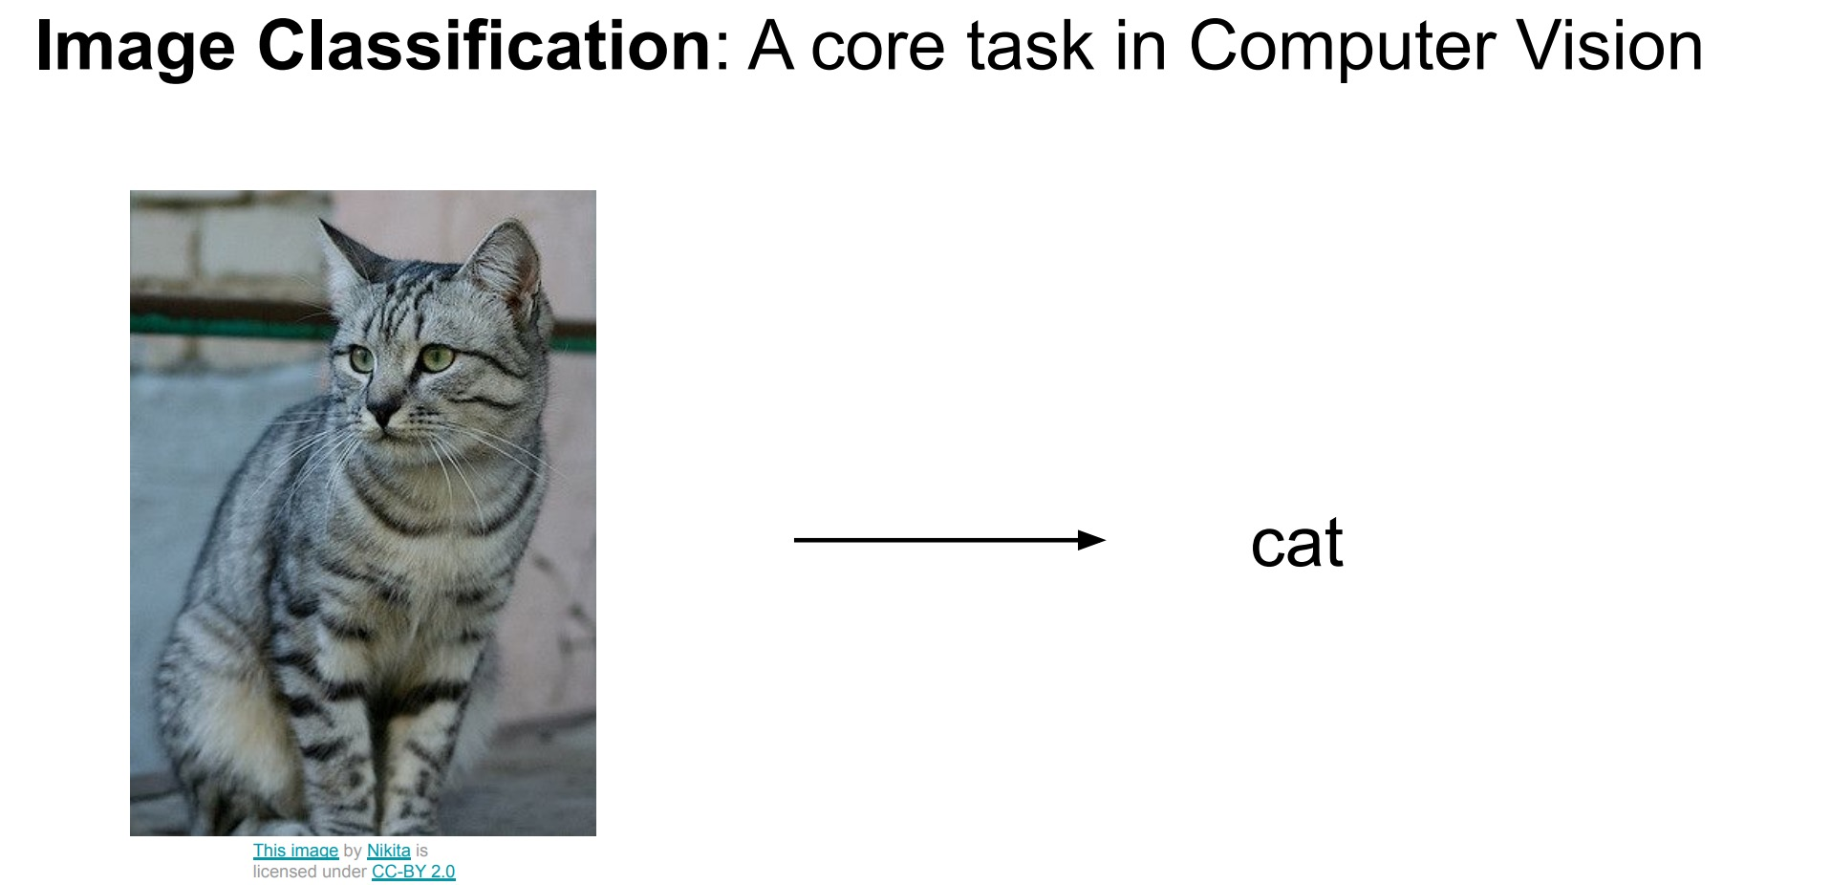

Slide 3
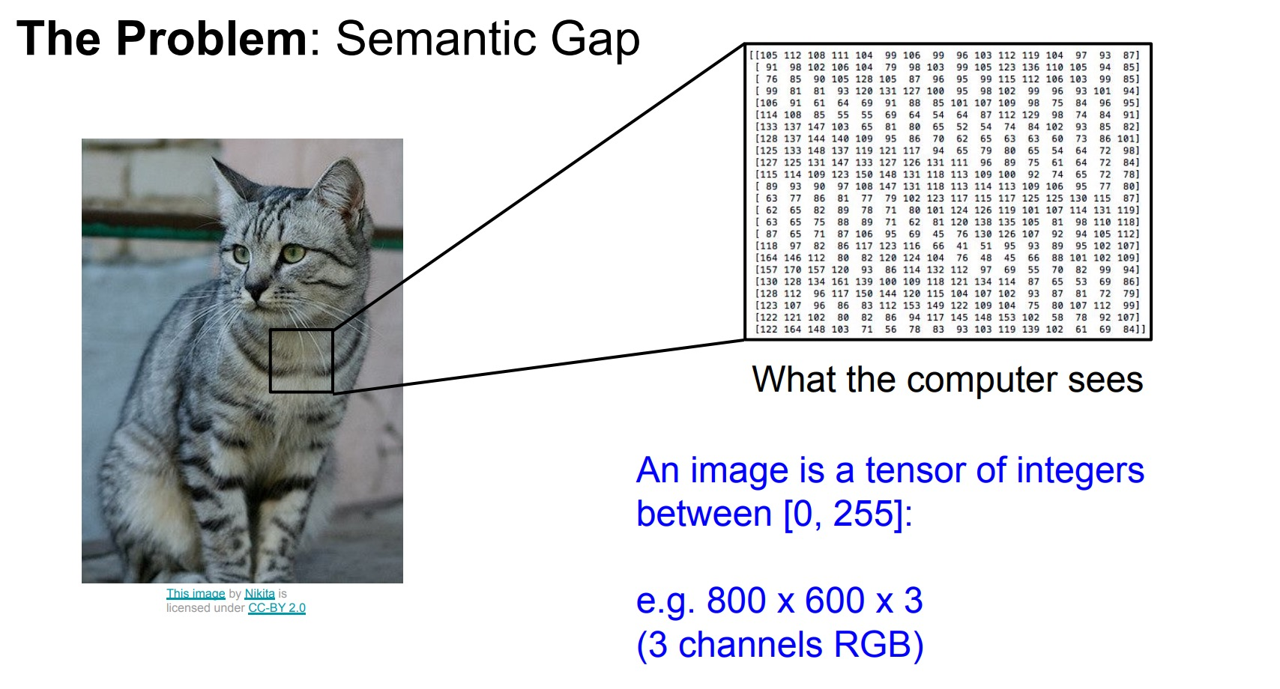

Slide 4
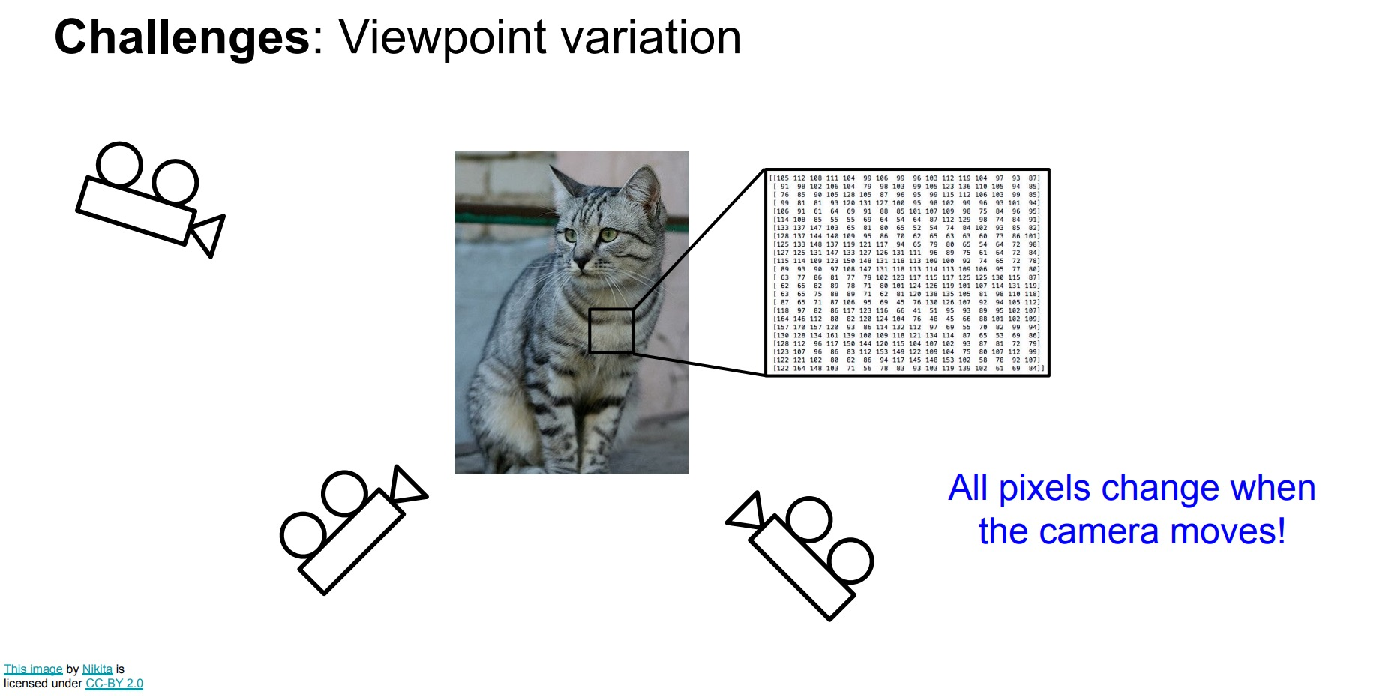

Slide 5
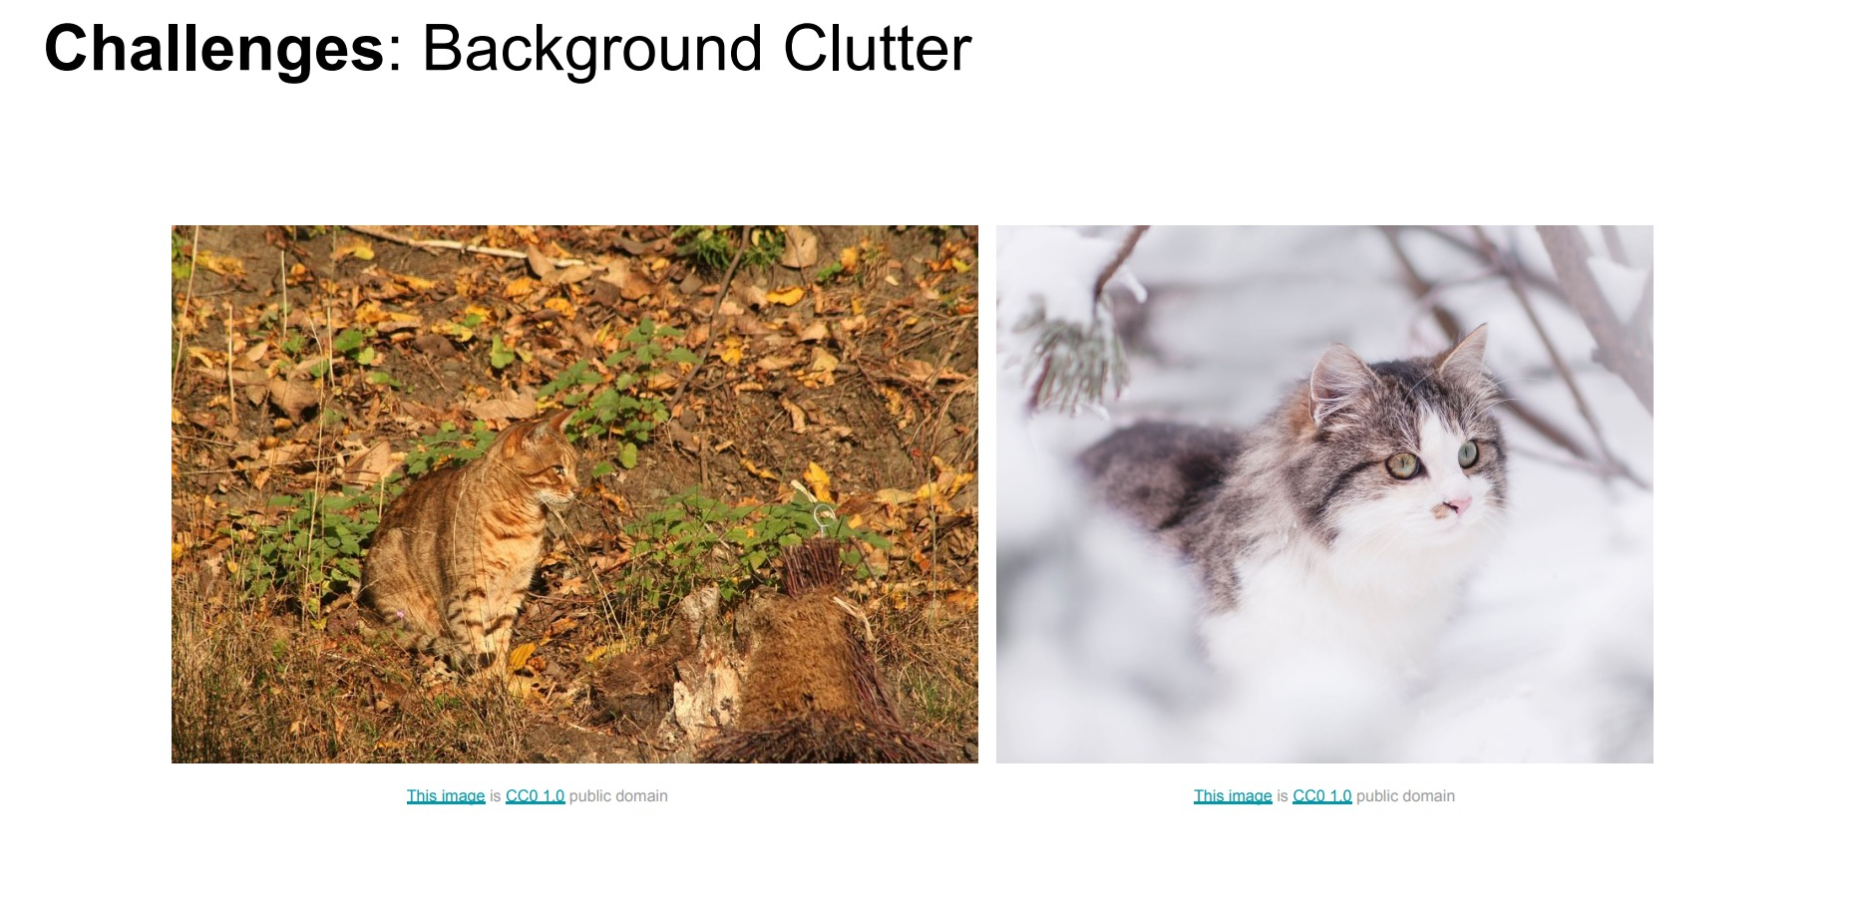

Slide 6
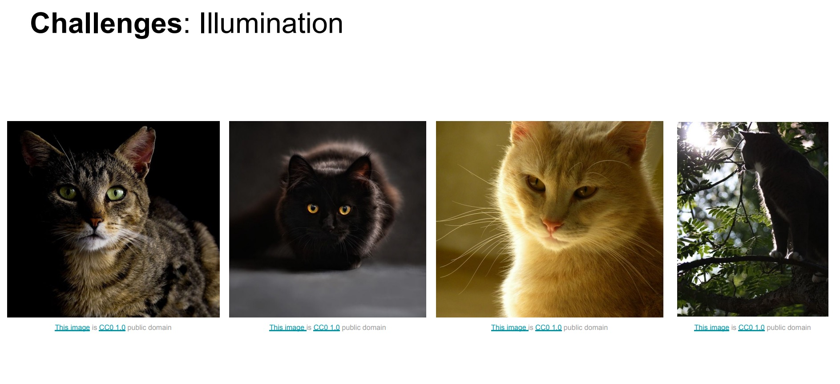

Slide 7
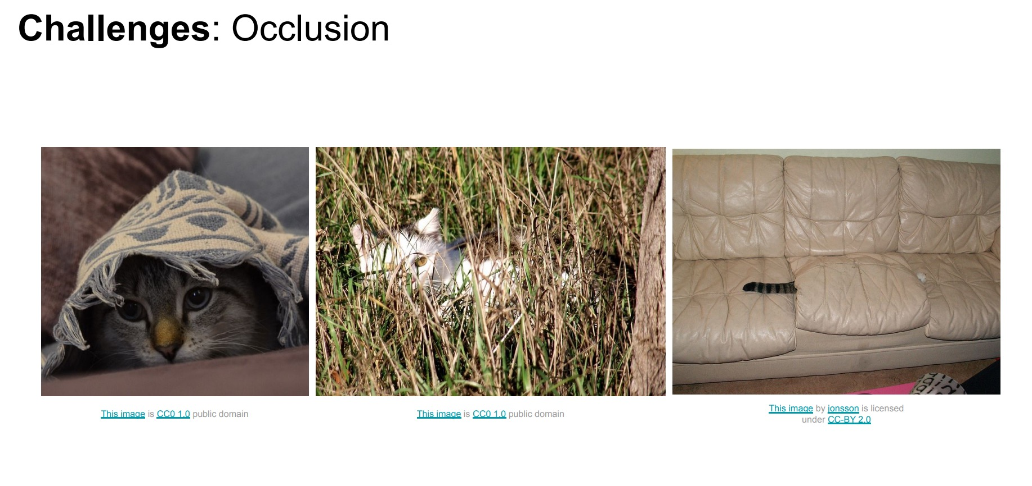

Slide 8
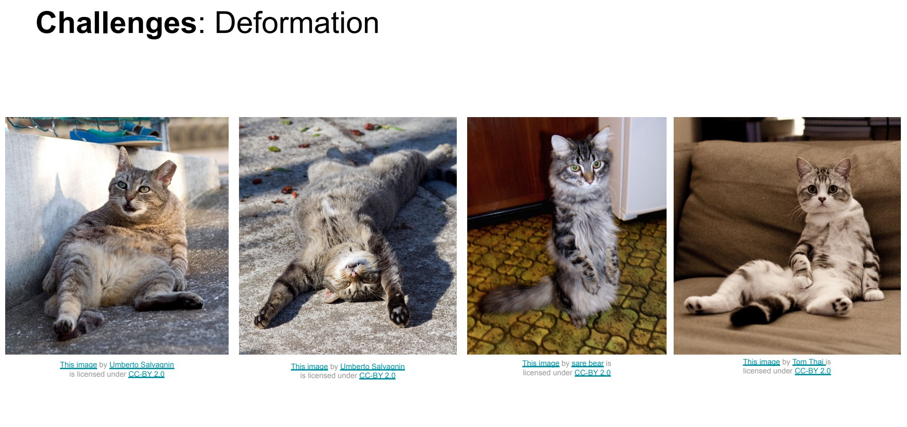

Slide 9
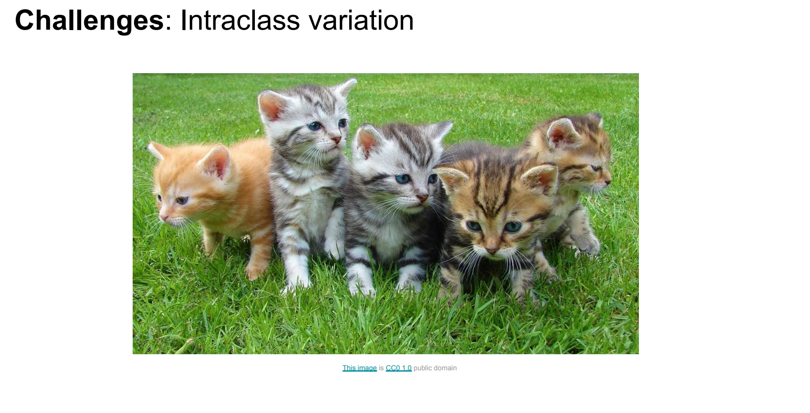

Slide 10
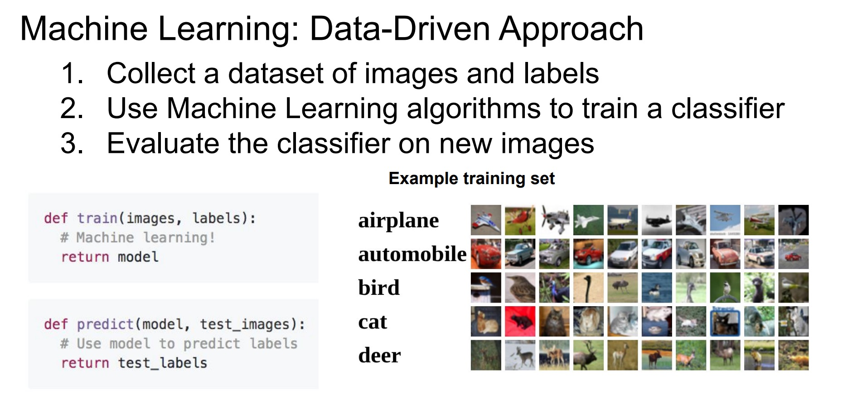

Slide 11
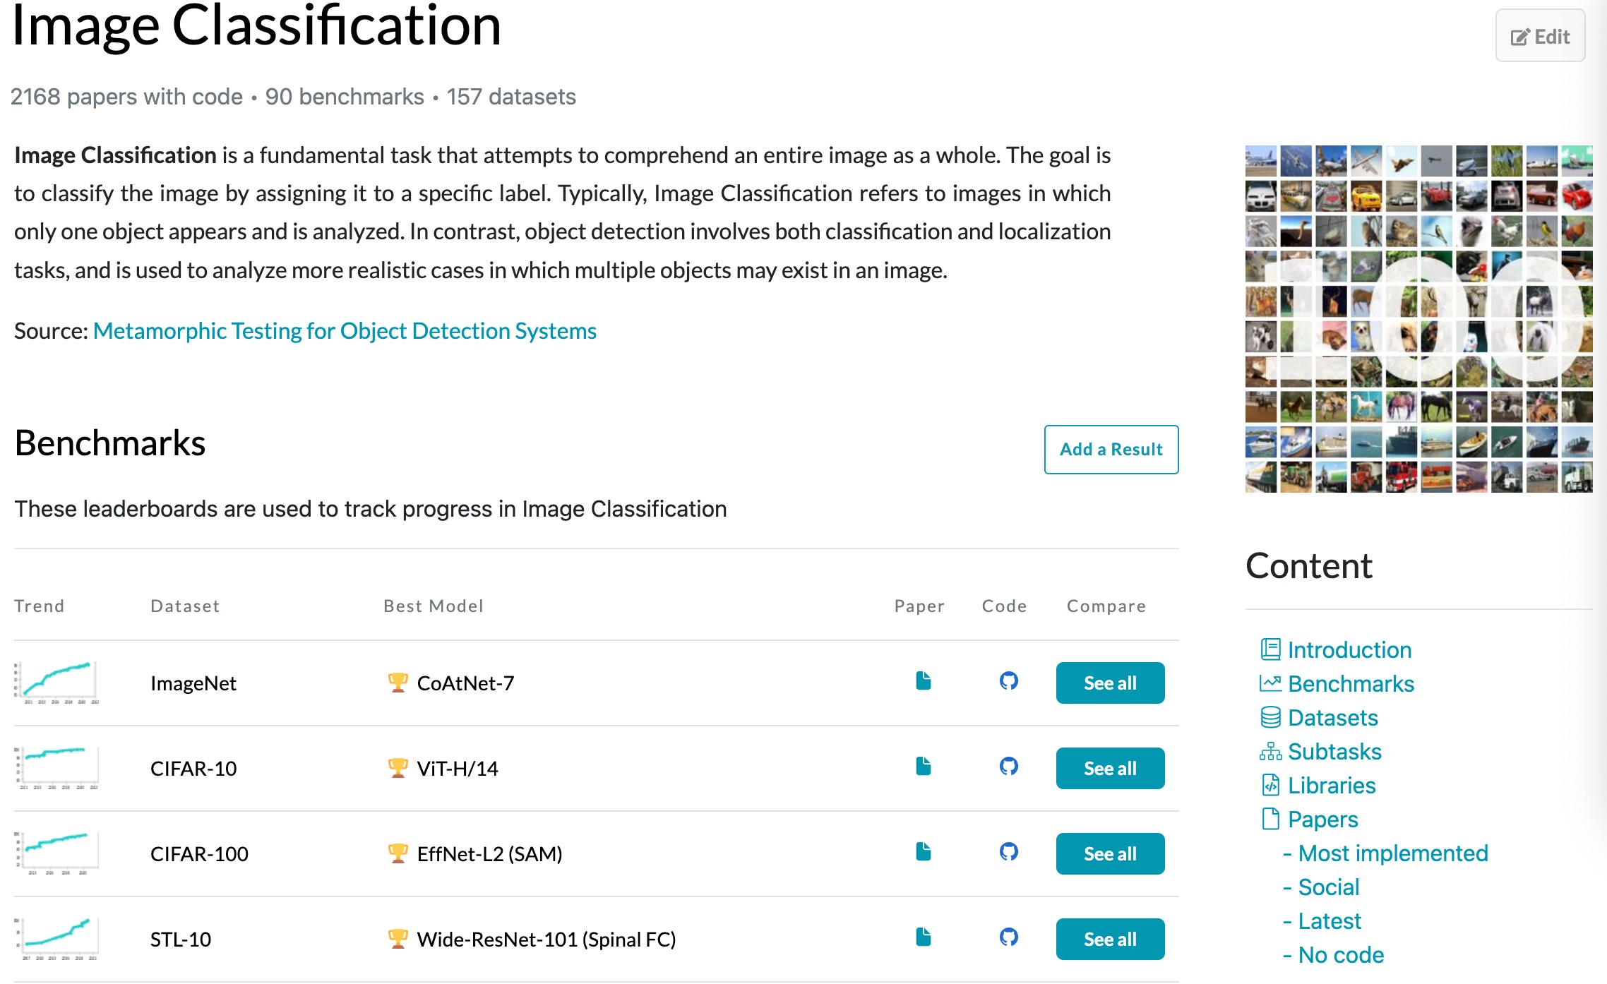
https://paperswithcode.com/task/image-classification

Slide 12
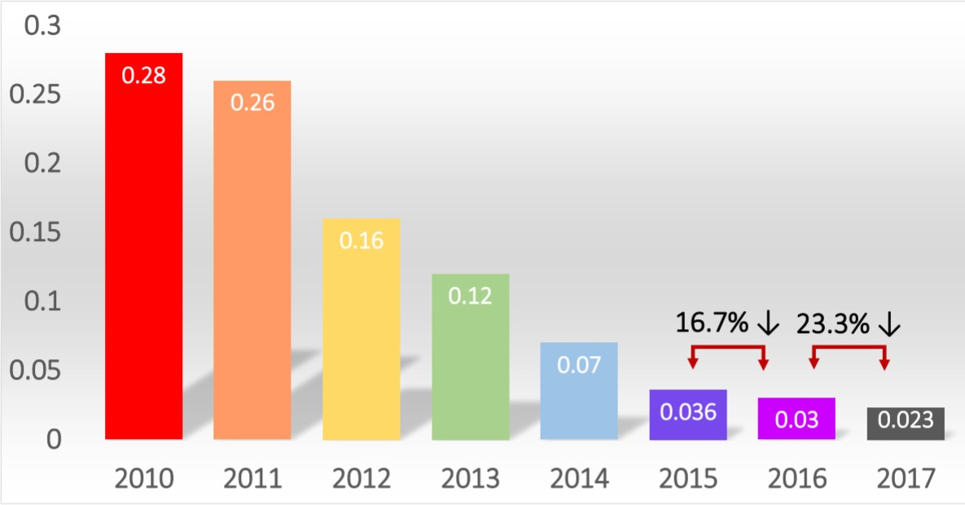
ImageNet Top-5 Error

Slide 13
However …
Training accurate deep neural network models usually requires lots of labeled data
Data collection and annotation is expensive, tedious, time-consuming.
Crowdsourcing may be infeasible for proprietary data.
For some tasks, data may not be available at all (long tail distribution)

Slide 14
Visual Learning with Limited Data
Zero-shot Learning
Few-shot Learning
Long Tail Recognition
Domain Adaptation and Transfer Learning
Learning with weakly labeled data
Active learning

Slide 15
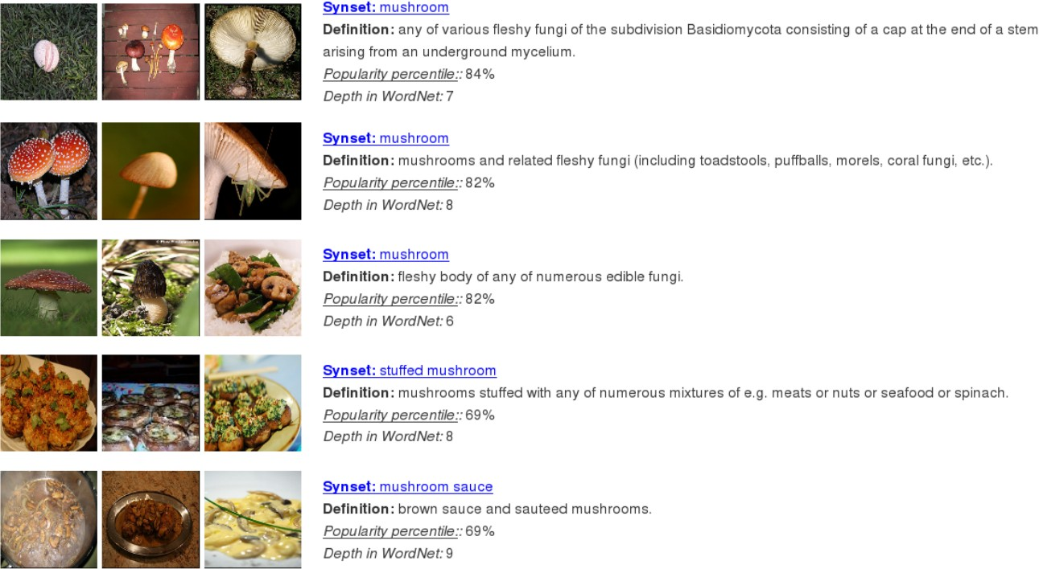
ImageNet has 30 mushroom synsets, each with ≈1000 images.
Slide credit: Christoph Lampert

Slide 16
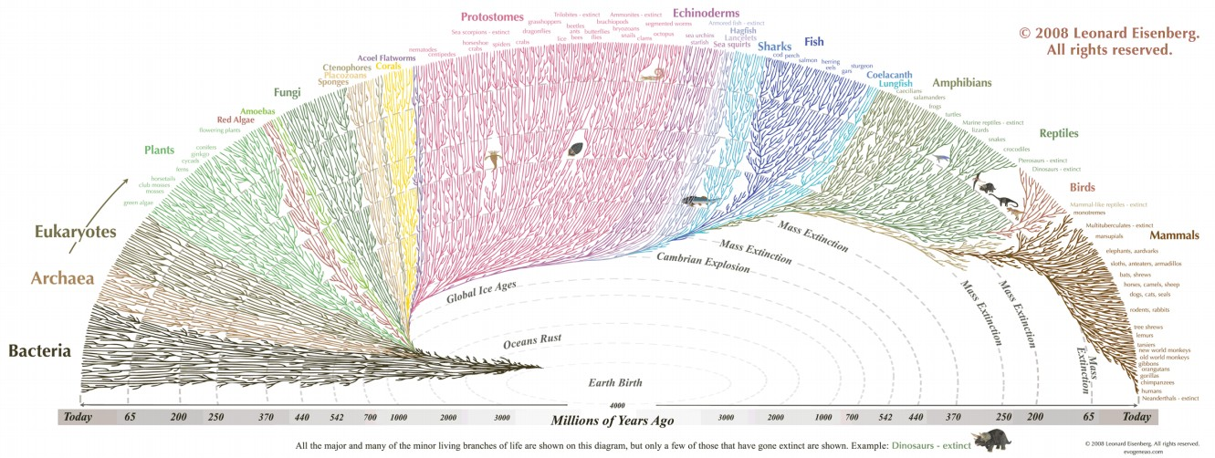
In nature, there are ≈14,000 mushroom species !
Many fine-grained visual categorization tasks may have classes with few or no training examples at all.
Slide credit: Christoph Lampert

Slide 17
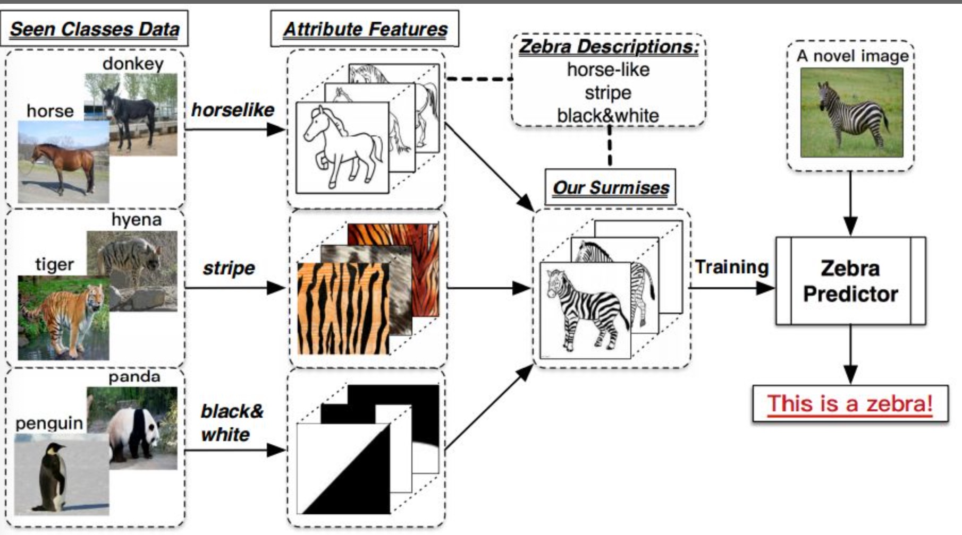
No training examples : Zero-shot Learning

Slide 18
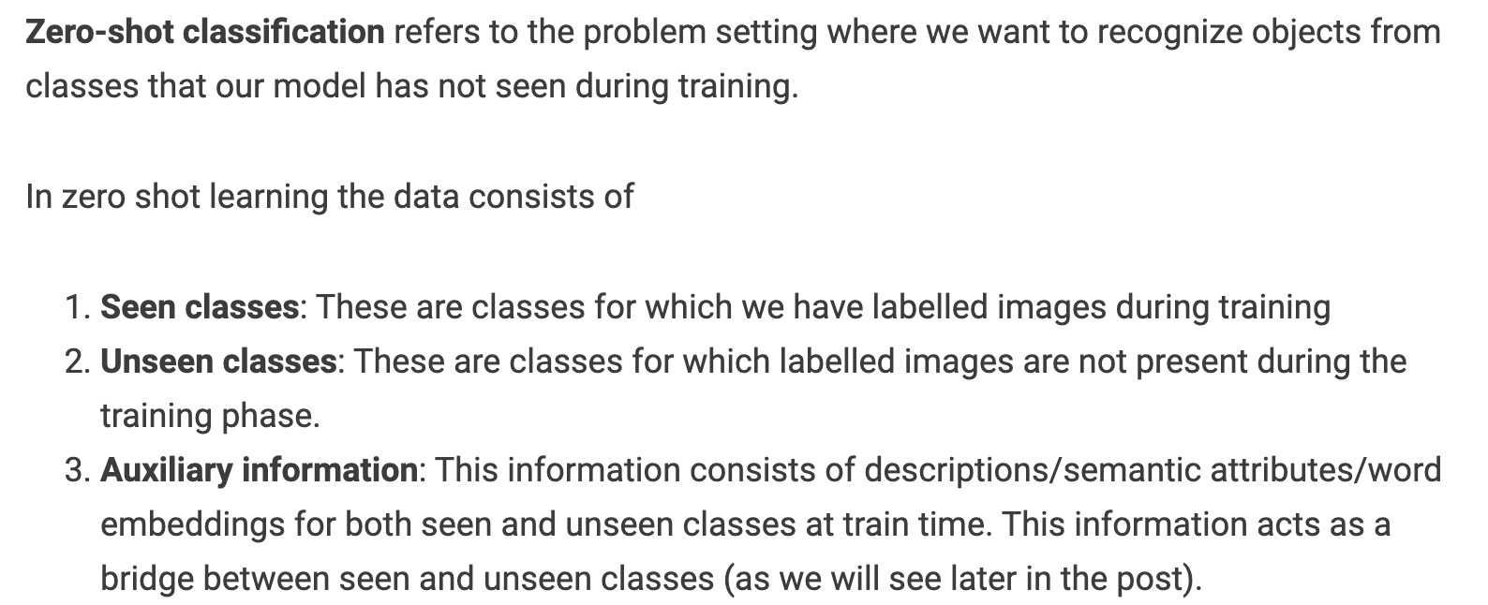
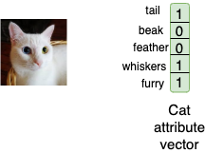

Slide 19
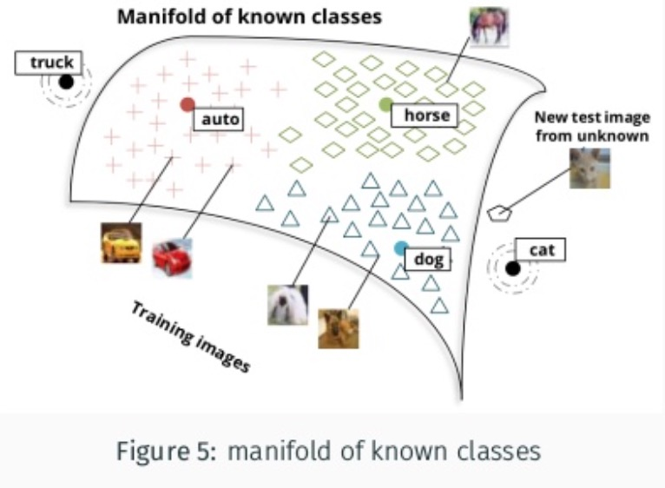
Visual semantic space

Slide 20
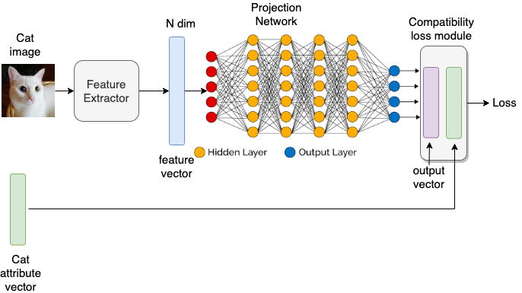
Embedding based methods

Slide 21
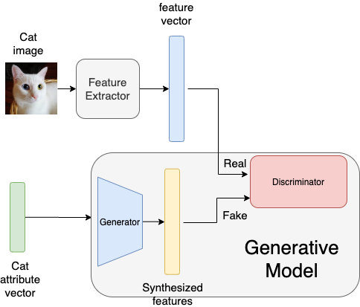
Generative model based methods

Slide 22
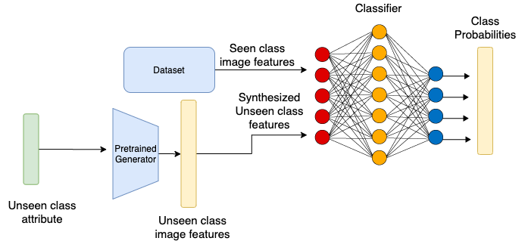

Slide 23
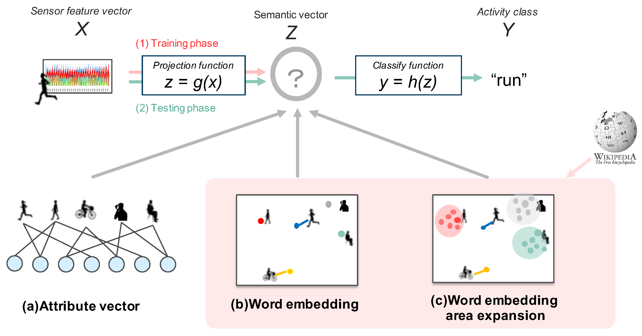

Slide 24
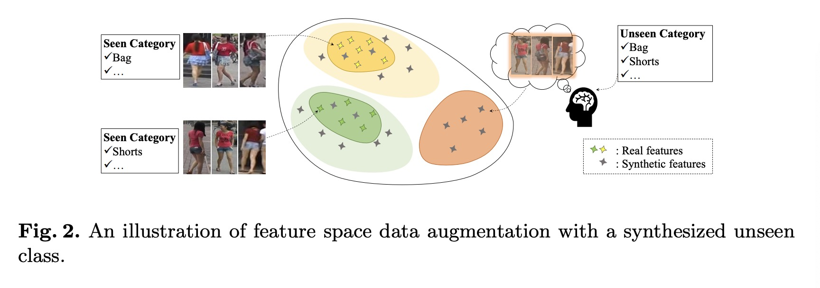
From zero-shot classification to zero-shot retrieval
Symbiotic Adversarial Learning for Attribute-based Person Search, ECCV 2020

Slide 25
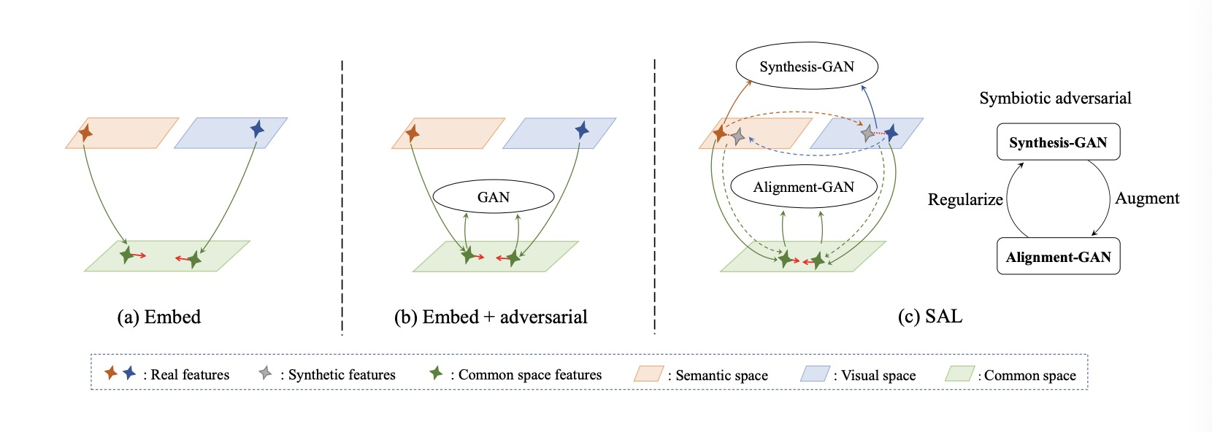
Symbiotic Adversarial Learning for Attribute-based Person Search, ECCV 2020

Slide 26
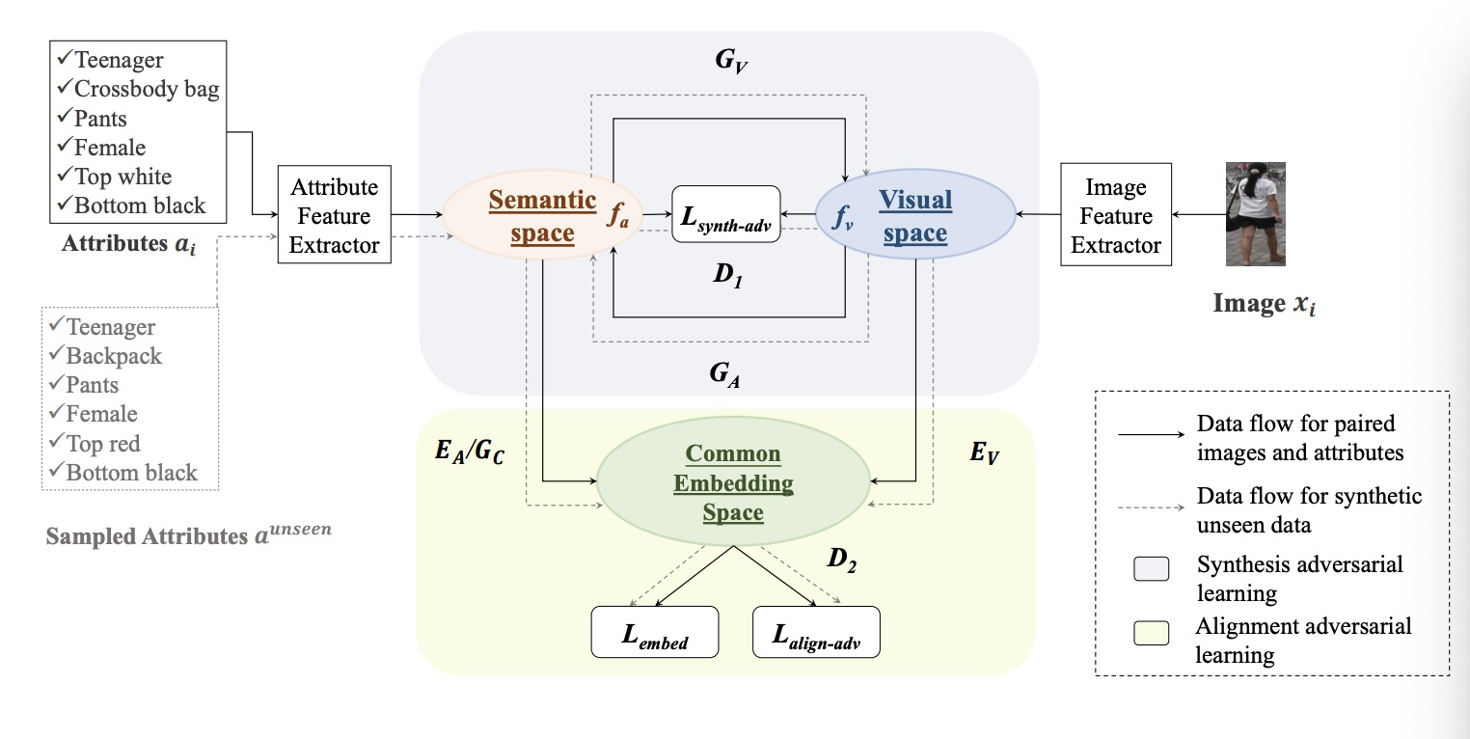
Symbiotic Adversarial Learning for Attribute-based Person Search, ECCV 2020

Slide 27
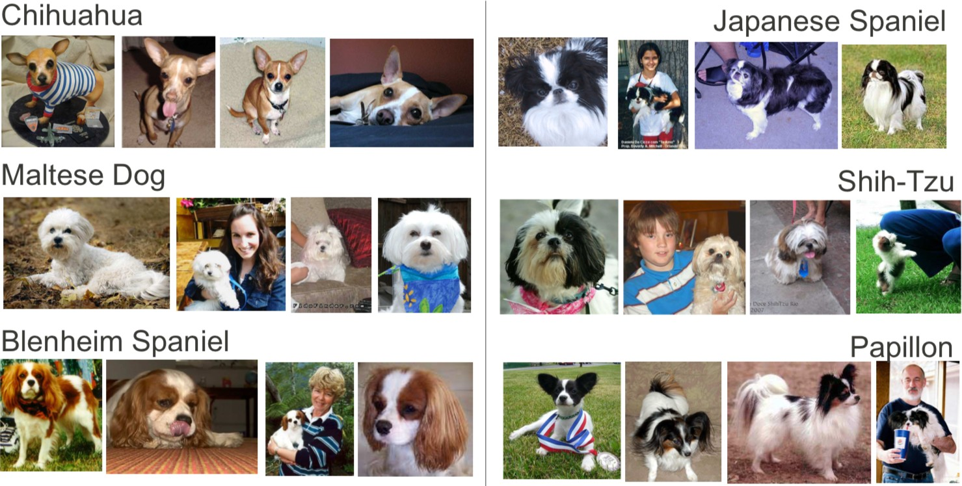
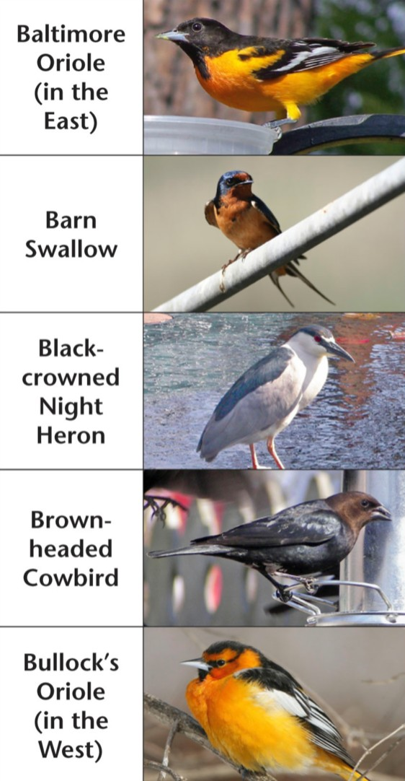
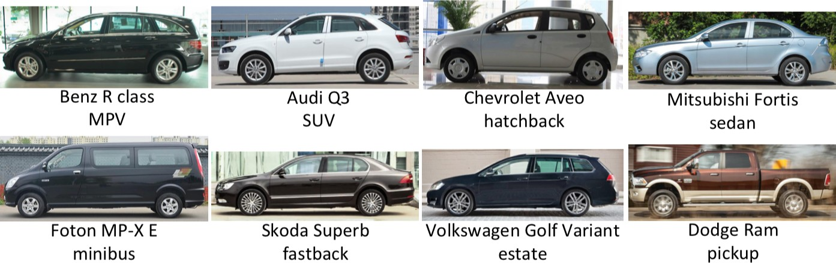
Few training examples -> Few-shot Learning

Slide 28


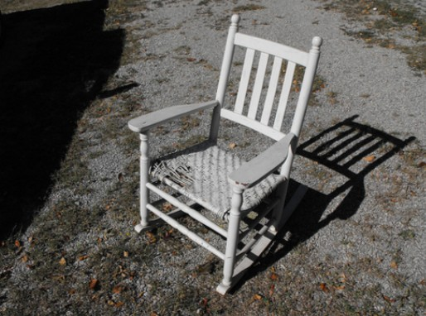
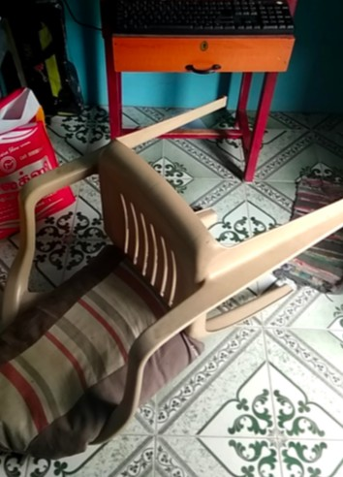
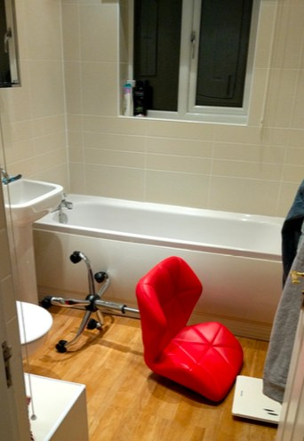
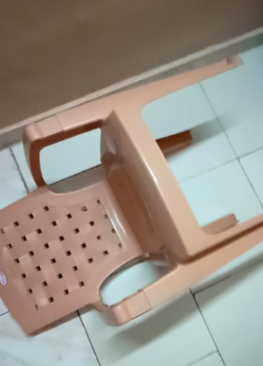
Classes with many examples may still suffer from bias !
ImageNet chairs
§ Few rotations/viewpoints
§ Typical backgrounds
Images from the ObjectNet dataset [Barbu et al., NeurIPS 2019]
ImageNet classifier fails to detect these chairs

Slide 29
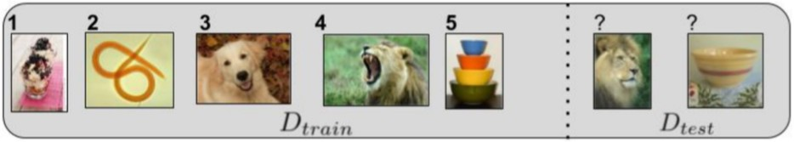
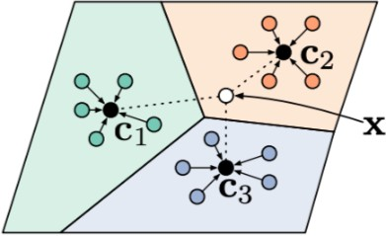
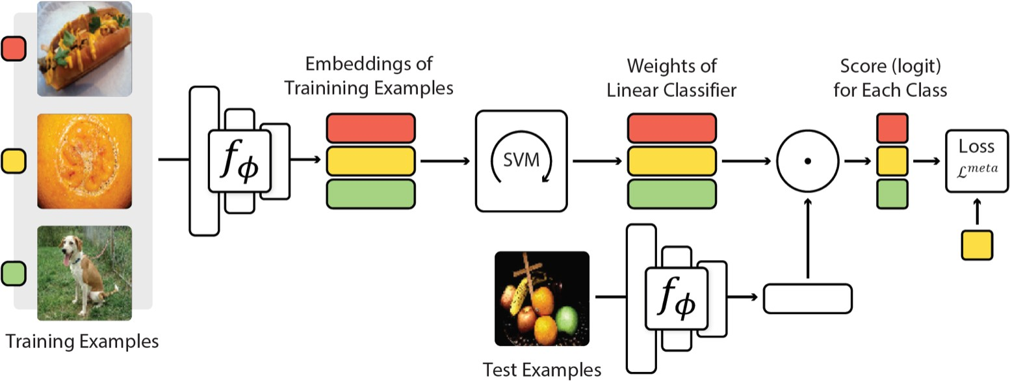
Few-shot Learning: Metric Learning and Meta-Learning
Prototypical Networks [Snell et al., NeurIPS 2017]
MetaOptNet [Lee et al., CVPR 2019]

Slide 30
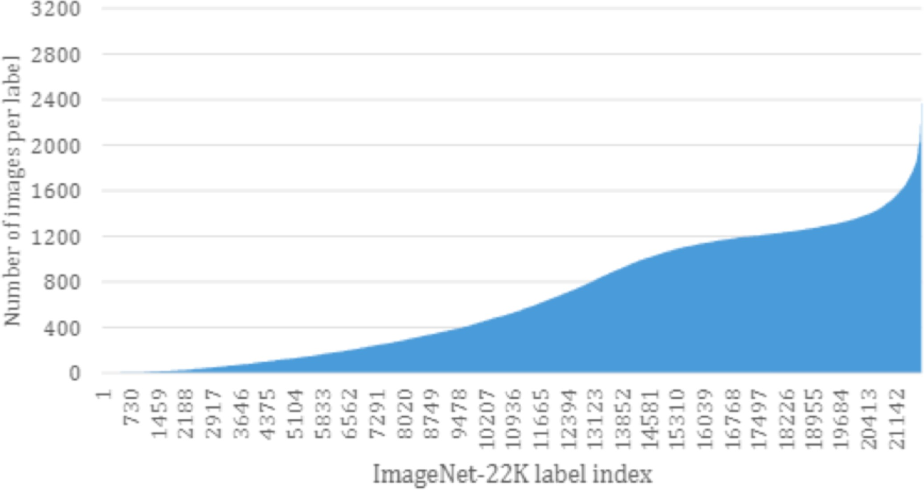
The Battle against the Long Tail…

Slide 31

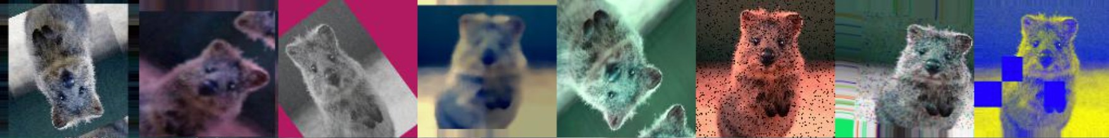
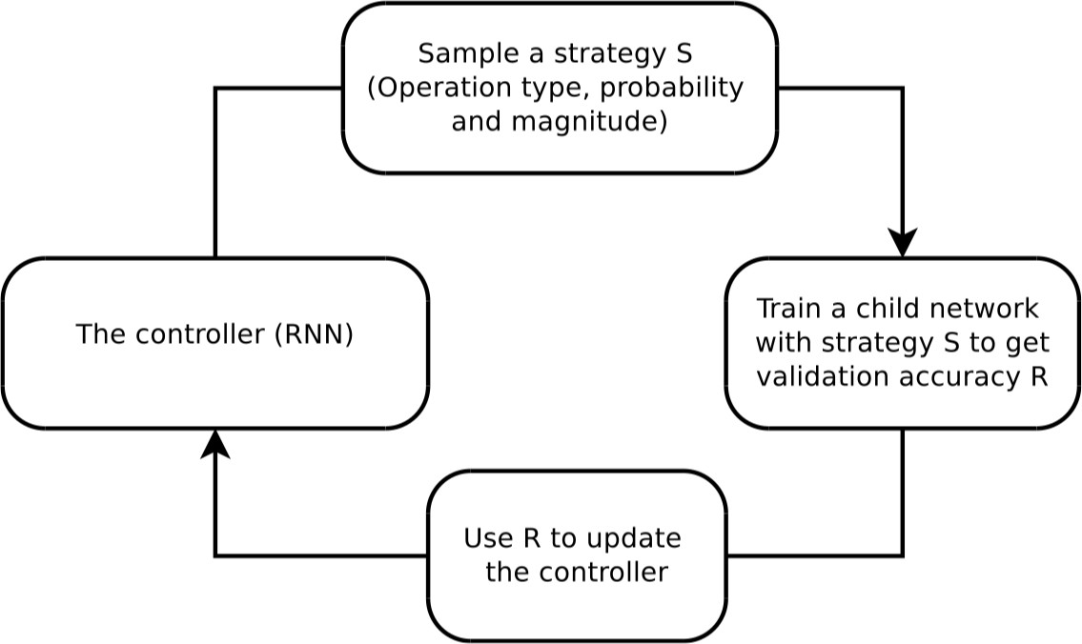
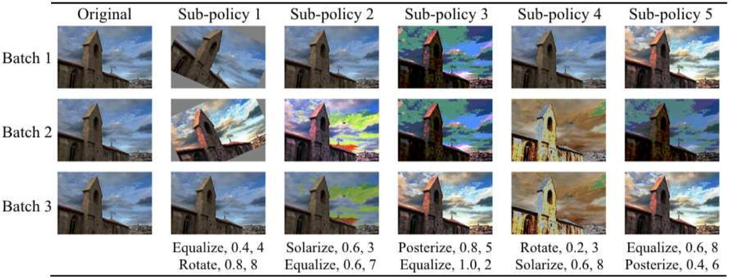
Data Augmentation and Synthesis
Img aug [https://github.com/aleju/imgaug]
AutoAugment [Cubuk et al., C V P R 2019]

Slide 32
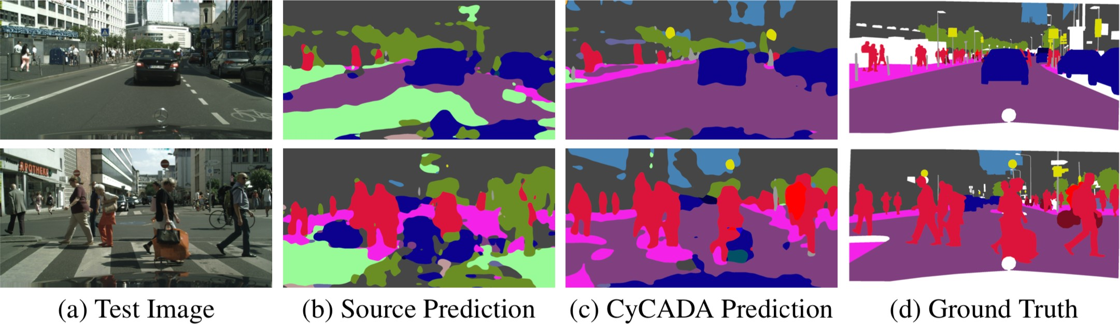
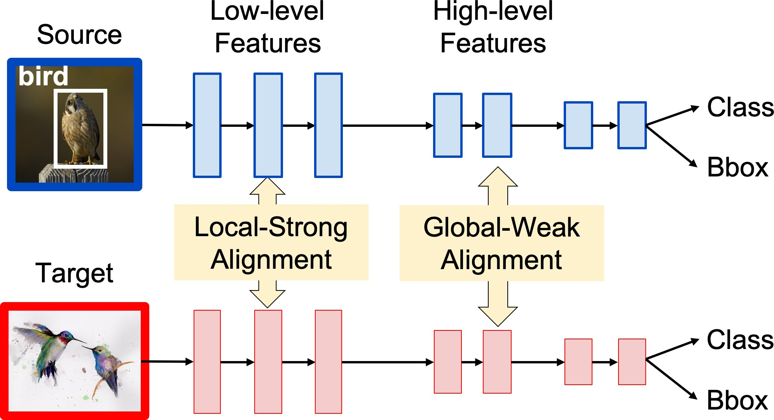
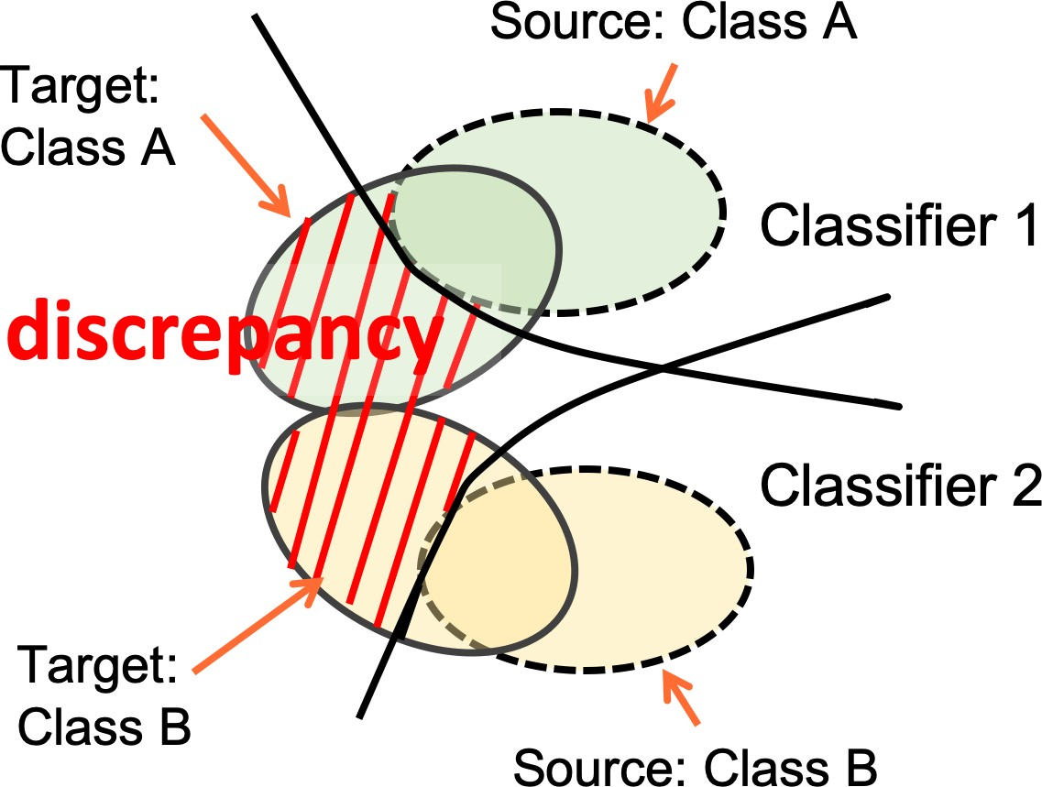
Domain Adaptation and Transfer Learning
CyCADA [Hoffman et al., ICML 2018]]
Weak Alignment [Saito et al., CVPR 2019]
Class-conditional Alignment

Slide 33
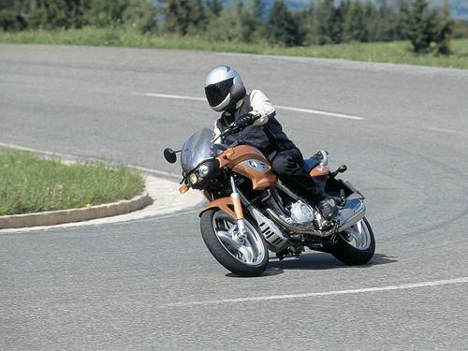





Manual supervision for object recognition
5
Small labeled data -> Weakly labeled data
{motorbike,person} {motorbike (point),
person (point)}
{motorbike (b-box), person (b-box)}
{motorbike (pixel labels), person (pixel labels)}
1 sec per class
2.4 sec per instance
10 sec per instance
78 sec per instance
annotation time
Berman et al., What’s the Point: Semantic Segmentation with Point Supervision, ECCV 16
Weak supervision
Lower degree (or cheaper) annotation at train time than the required output at test time

Slide 34






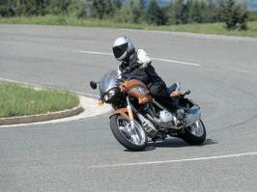




Manual supervision for object recognition
6
Regular supervision
Task in test
pixel label
bounding box
strong supervision
image label
image label
pixel label
Training supervision
bounding box

Slide 35
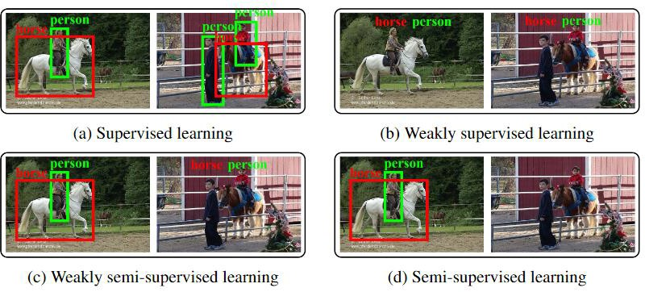
Related topics: semi-supervised learning
7
Semi-supervised: learns from a set of labeled (bounding box) and unlabeled images
[Wang CVPR 19]
Weakly semi-supervised: learns from a set of labeled (bounding box) and weakly labeled (image label) images
[Yan arXiv 1702.08740]
Image credit: [Jeong 19 NeurIPS]

Slide 36
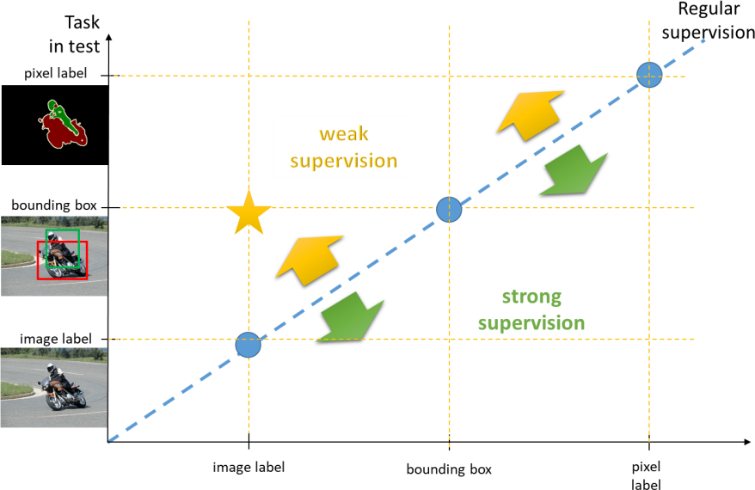
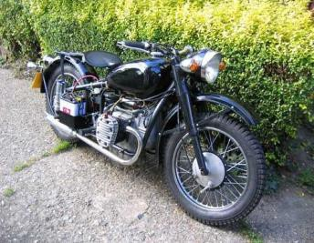
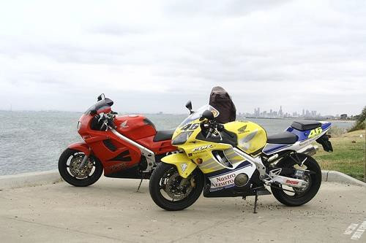


Weakly supervised object detection
14
Hakan Bilen
Focuses on object detection with image-level supervision
Object detection model
Loss
motorbike
Reading List: https://hbilen.github.io/wsl-eccv20.github.io/

Slide 37





Weakly supervised semantic segmentation
15
Rodrigo Benenson
Cat
Cat
Cat
Cat
Cat
Cat
Discusses use of image-labels and box-labels, for semantic and instance segmentation.

Slide 38




Human-in-the-loop annotations
16
Rodrigo Benenson
Describes active learning strategies for box and segmentation annotations.
Detection
Semantic labeling
Which boxes to add?
Which pixels to add?

Slide 39
Thanks

